Slide 1

Stabilspork
(Healthcare)

Slide 2

Introduction
The problem covers the people suffering from Tremor disorder, teaching kids table manners and helping old aged people to become self-dependent to eat food.
The self-stabilizing spoon acts like a gimbal, shifting its spoon head to counteract the user's tremors. It starts with calibrating itself and getting an initial measurement of the angle it is at. Now, once that angle changes, a command to reposition is sent to the motors.

Slide 3
Outline to the project
PROBLEM STATEMENT
IDEOLOGY
SOLUTION
COMPONENTS
CONNECTIONS
TECHNOLOGY INVOLVED
USP

Slide 4




PROBLEM STATEMENT
Tremors are a neurological condition that affect the day to day life of a person in adverse ways. This leads to a person being incapable of doing a variety of basic tasks such as eating without spilling the food.
This is mostly experienced by people facing anxiety along with the elderly which makes them feel helpless in doing basic things like eating.

Slide 5

IDEOLOGY
This project would include a self stabilizing spoon which would include an adjustable handle according to users needs.
It would also include detachable spoon and fork for persons to enjoy their meal.
The detachable spork can be changed after some time to maintain hygiene.
This product is durable and cost efficient for person’s convenience.

Slide 6

solution
Stabilspork is a device that maintains its original position regardless of the users motions, which allows the food to stay on it.
The proposed idea also helps in teaching young kids to learn the table manners by making them understand the functioning of fork and spoon.

Slide 7
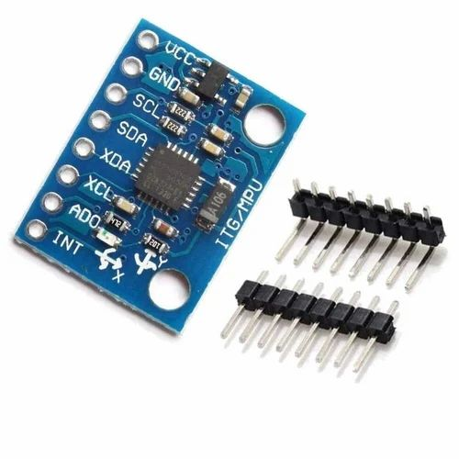
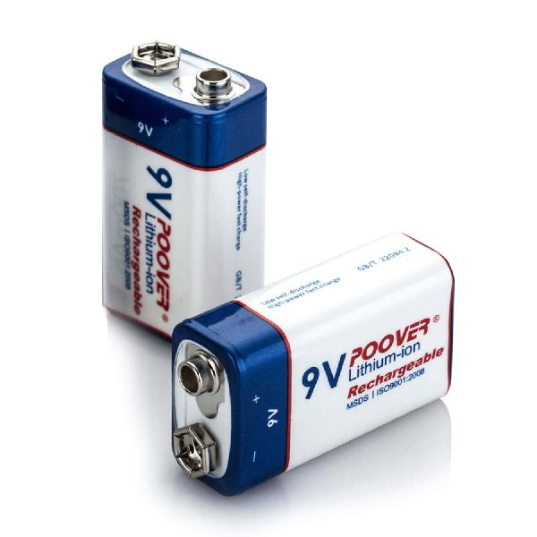
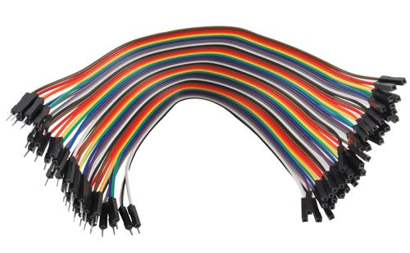
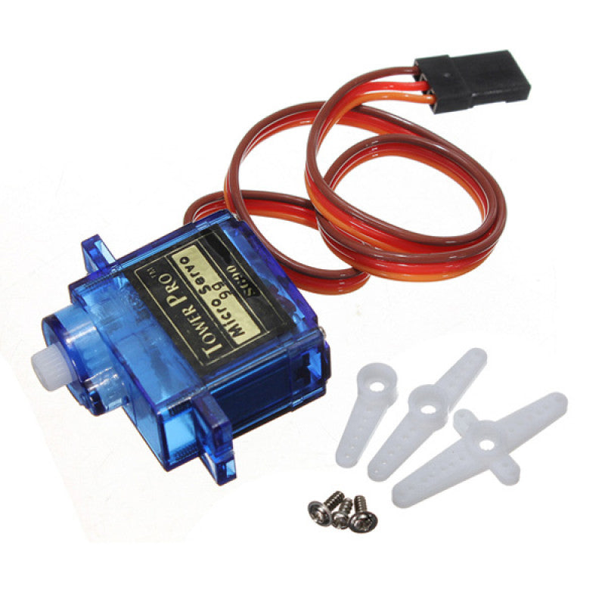
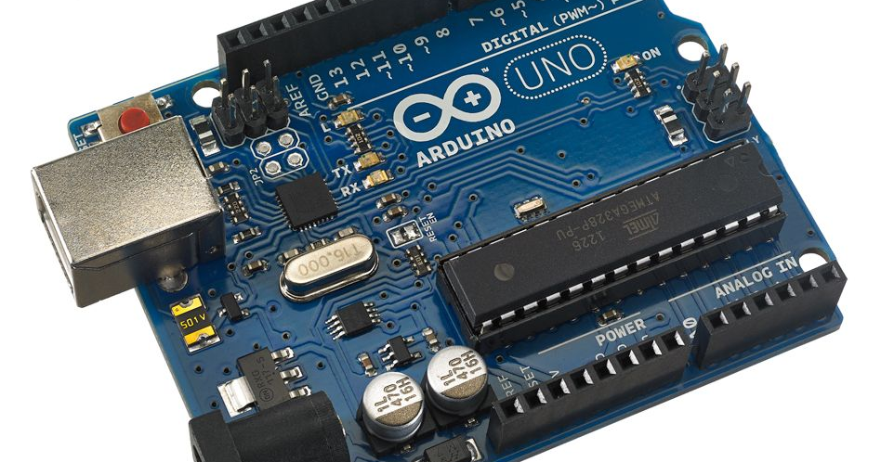
COMPONENTS USED

Slide 8
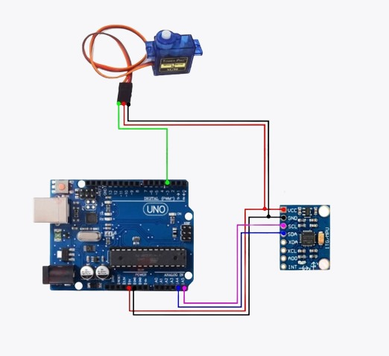
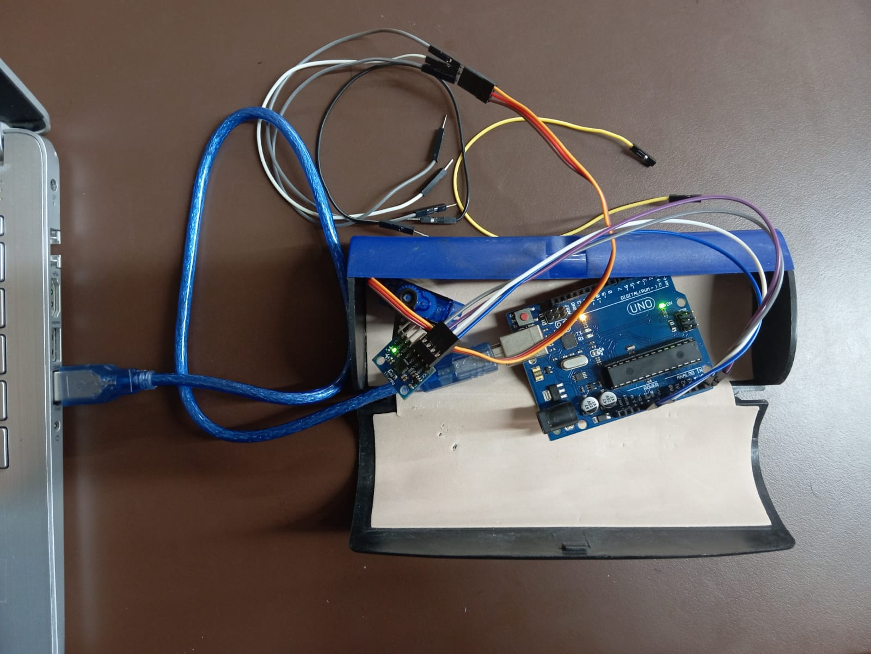
CONNECTIONS

Slide 9

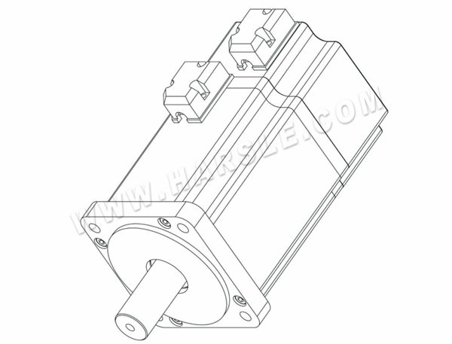
TECHNOLOGY INVOLVED
The servo motors controls the motion of the spoon in all the axis’s in each direction that the user bends
Gyroscopic approach will be shown by MPU6050 which controls and captures the motions of user for record.

Slide 10
Usp (unique selling point )
Price bracket
Material used
ADJUSTABLE AND LIGHT WEIGHT
(2500-3000Rs)
food-grade rubber is less harmful, lighter and cheaper and better shock absorber to food being catered in it
Length of the spoon can be adjusted electrically according to the need of the user
User friendly as it is lighter than expected, due to light weight plastic.

Slide 11
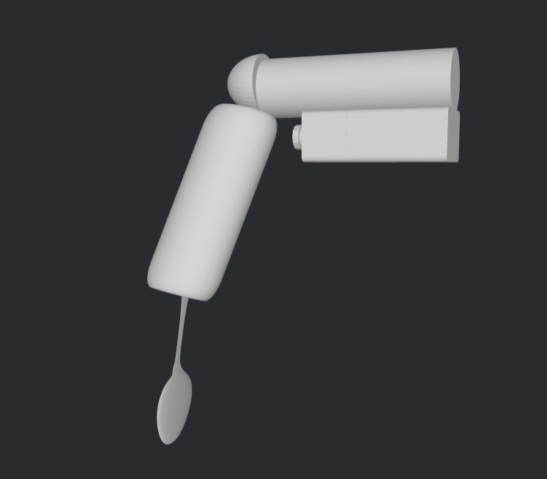
3D MODEL

Slide 12
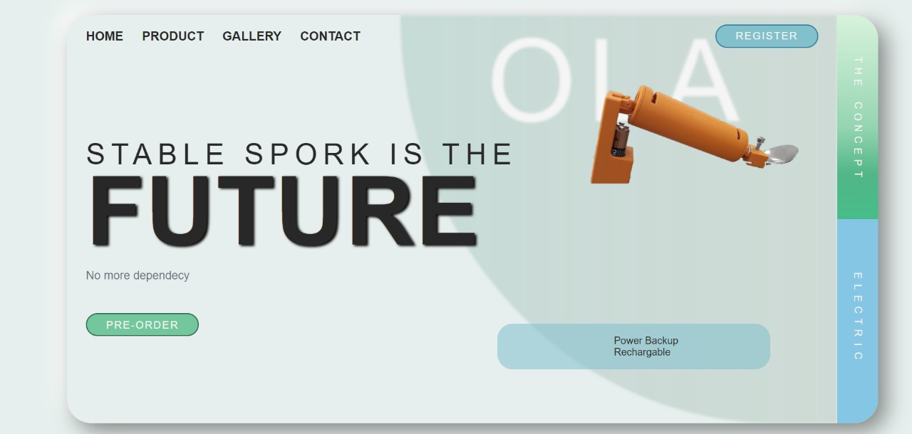
WAIT WAIT THAT’S NOT THE END WE HAVE MADE THE WEBSITE TOO!!

Slide 13



MEET OUR TEAM
SEHAJ KUNDRA (BE-MECH)
SURAJ SETIA (TEAM LEADER) (BE-CSE)
MANAV MUNJAL
(BE-MECH-CSE)

Slide 14
Thank you

